Slide 1

PPP
Presentation on
Used Car Price Prediction
Notes:
PRESENTED BY ---NAMRATA BARASKAR

Slide 2
Agenda
Introduction
Problem Statement
Problem Understanding
What Is Used Car Price?
Benefits of Buying Used Car
Importance of Used Cars
Data Analysis & Model Building Flowchart
Exploratory Data Analysis Steps
Visualizations: Univariate and Bivariate
Data Analysis Steps Done
Assumptions
Model Building
Hyper Parameter Tuning and Crating Final Model
Saving the model and prediction results
Conclusion

Slide 3
Introduction
Predicting the price of used cars is an important and interesting problem. Predicting the resale value of a car is not a simple task. It is trite knowledge that the value of used cars depends on a number of factors.
The most important factors are usually the age of the car, its make (model), the origin of the car (the original location of the manufacturer), its mileage (the number of kilometres it has run) and its horsepower (amount of power that an engine produces).
Due to rising fuel prices, fuel economy is also of prime importance. Unfortunately, in practice, most people do not know exactly how much fuel their car consumes for each km driven. Other factors such as the type of fuel it uses, the interior style, the braking system, engine displacement, its size, number of doors, paint colour, weight of the car, consumer reviews, its physical state, whether it is automatic or manual transmission, whether it belonged to an individual or a company and other options such as air conditioner, sound system, power steering all may influence the price as well.
Some special factors which buyers attach importance is the local of previous owners, whether the car had been involved in serious accidents. The look and feel of the car certainly contribute a lot to the price. As we can see, the price depends on a large number of factors. Unfortunately, information about all these factors are not always available and the buyer must make the decision to purchase at a certain price based on few factors only. In this work, we have considered only a small subset of the factors which are more important.

Slide 4
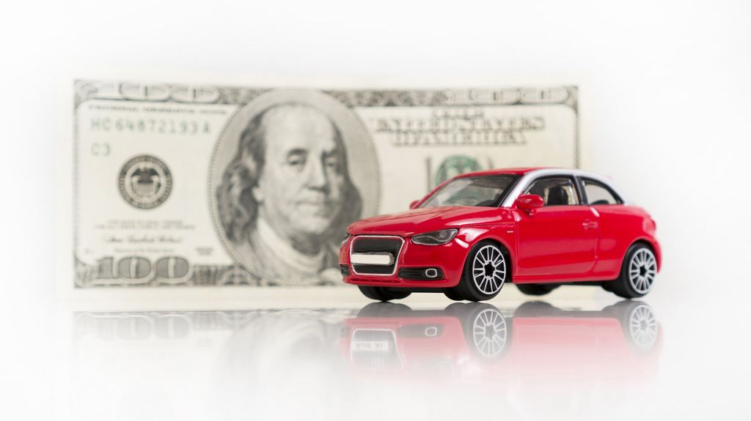
Problem Statement
With the covid 19 impact in the market, we have seen lot of changes in the car market. Now some cars are in demand hence making them costly and some are not in demand hence cheaper. One of our clients works with small traders, who sell used cars. With the change in market due to covid 19 impact, our client is facing problems with their previous car price valuation machine learning models. So, they are looking for new machine learning models from new data. We have to make car price valuation model.
Business goal: The main aim of this project is to predict the price of used car based on various features. Machine Learning is a field of technology developing with immense abilities and applications in automating tasks. So, we will deploy an ML model for car selling price prediction and analysis. This kind of system becomes handy for many people. This model will provide the approximate selling price for the car based on different features like fuel type, transmission, price, weight, running in kms, engine displacement, milage etc and this model will help the client to understand the price of used cars.

Slide 5

Problem Understanding
Car Price Prediction is really an interesting machine learning problem as there are many factors that influence the price of a car in the second-hand market. Here we are trying to help the client works with small traders, who sell used cars to understand the price of the used cars by deploying machine learning models. These models would help the client/sellers to understand the used car market and accordingly they would be able to sell the used car in the market.
From the problem statement we came to know that it is a regression type problem since our target variable “Car_Price” is continuous hence we need to build regression algorithms to predict the price of used cars.

Slide 6

What is Used Car Price?
A used car, a pre-owned vehicle, or a second hand car, is a vehicle that has previously had one or more retail owners. Used cars are sold through a variety of outlets, including rental car companies, independent car dealers, buy here pay here dealerships, leasing offices, auctions, and private party sales. Used car pricing reports typically produce three forms of the pricing information.
Dealer or retail price is the price expected to pay if buying from a licensed new-car or used-car dealer.
Dealer trade-in price or wholesale price is the price a shopper should expect to receive from a dealer if trading in a car. This is also the price that a dealer will typically pay for a car at a dealer wholesale auction.
Private-party price is the price expected to pay if buying from an individual. A private-party seller is hoping to get more money than they would with a trade-in to a dealer. A private-party buyer is hoping to pay less than the dealer retail price.

Slide 7
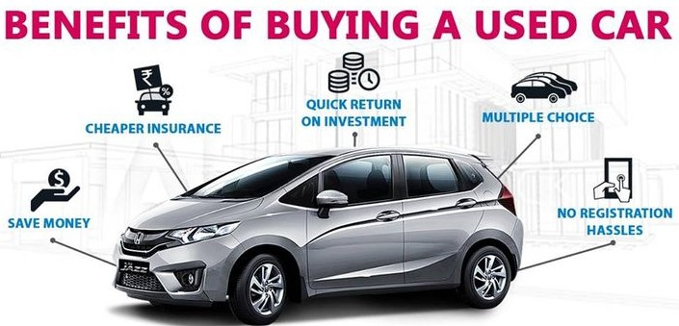
Benefits of Buying Used Cars:
Save Money
Used Cars Have The Features That You Want
Lower Insurance Rates
Good Condition
Falling Registration Fees
Depreciation Advantages
Vehicle History Reports Make Used Purchases Less Risky
Used Cars Have Rich Aftermarket Communities
The Ideal Starting Partner
Used Cars Are Just As Capable As New Cars

Slide 8
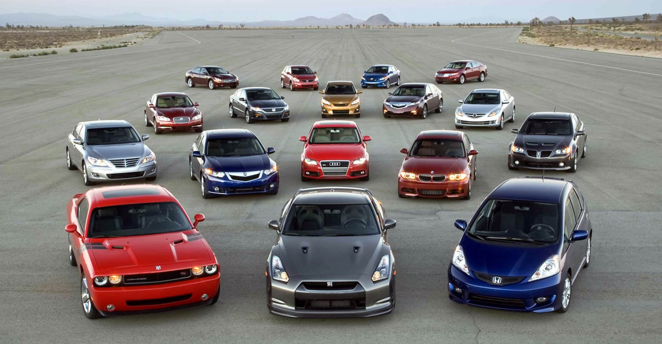
Importance of Used Cars:
There are certain things that will tell you the importance of buying a used car rather than a new car, they are as follows:
Experts say when a new car leaves the lot, its value gets depreciated by less than or equal to 10% of its original price for which it is bought. The value gradually gets depreciated every month and year. But in case of a used car, the depreciation has already occurred a lot times. Amazingly, some may have got its value increased too.
The price of a new car will usually be high. Also a lot amount of rupees that are hidden from you such as for
shipping purposes will be charged extra. But in case of used cars there are no such extra fees charged. But few hundred rupees will somehow be charged for documentation fee.
A used car need not be added with extra fittings which are always expensive when it has to be installed in a new car. For a used car you can add extra fittings of your own preference with low budget. This will help you save money.
The pre-owned cars are checked for repairs and get refurbished. A certification is provided ensuring the vehicle is of good quality after a complete inspection is done.
The emission of carbon dioxide from the vehicle is dangerous to our environment. A new car will tend to emit more of this gas from manufacturing till its last usage. So if you are buying a used car, then the emission during its manufacture is reduced which is good to our surroundings.

Slide 9
Data Analysis and Model Building Flowchart
Import Libraries
Import Collected Dataset
Data Preprocessing
Identifying Outliers and Skewness
Visualizations
(EDA)
Finding and Treating Null Values
Label Encoder
Checking Correlation and VIF
Model Building
Saving the Model & Predictions
Hyper Parameter Tuning
R2 score, CV & Evaluation Metrics

Slide 10
Exploratory Data Analysis (EDA) Steps
Importing necessary libraries and importing dataset as a data frame.
Checked some statistical information like shape, number of unique values present, info, data types etc.
From the dataset I found some numerical features having “-“ sign and string value like “null” so I replaced them with NAN values and dropped the columns having more than 50% of “-“ sign as they were of no use for prediction.
Done feature engineering on some features as they had some irrelevant values and replaced them with appropriate values.
Extracted the features Brand, Model and Manufacturing_year from the column Car_Name and created Car_age by subtracting the Manufacturing year of car from the year 2021.
Converted all the numerical continuous columns from object data type into float data type after cleaning the data.
Checked for null values and treated them using imputation techniques like mean, median and mode methods. Checked the statistical summary of the dataset using describe () method.
Visualizing the features using univariate, bivariate and multivariate analysis. Visualized each feature using seaborn and matplotlib libraries by plotting several categorical and numerical plots like pie plot, count plot, bar plot, reg plot, strip plot, line plot, violin plot, distribution plot, box plots and pair plot.
Identified outliers using box plots and removed outliers in continuous numerical columns using Zscore.
Checked for skewness and removed skewness in numerical columns using power transformation method (yeo-johnson).
Used Pearson’s correlation coefficient to check the correlation between label and features. With the help of heatmap and correlation bar graph was able to understand the Feature vs Label relativity and insights on multicollinearity amongst the feature columns.

Slide 11
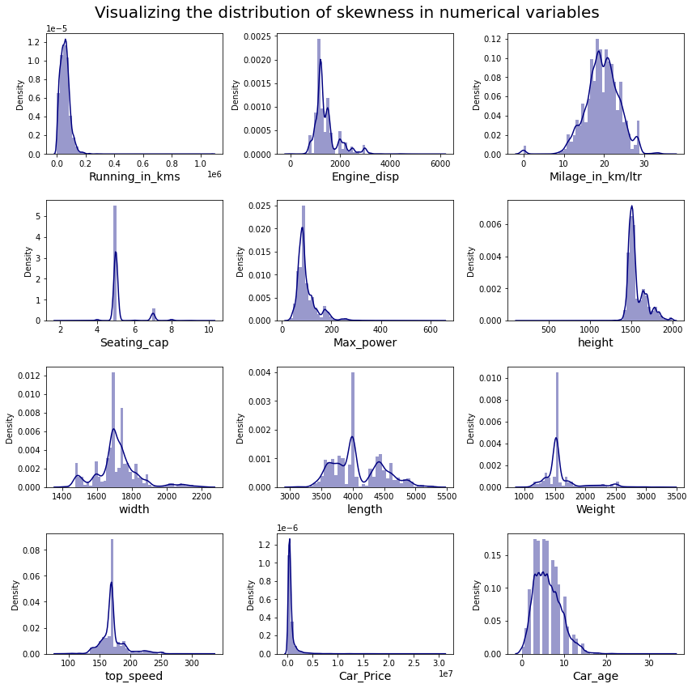
Visualization :Univariate Analysis
The distribution plot shows how the data has been distributed in each of the columns.
From the distribution plots we can observe most of the columns are not normally distributed, only the columns "Milage_in_km/ltr" looks somewhat normal.
Also, we can notice the columns like "Running_in_kms","Engine_disp", "Max_power", "Weight", "Car_age" etc are skewed to right as the mean value in these columns are much greater than the median (50%).
The data in the column "height" skewed to left since the mean values is less than the median.

Slide 12
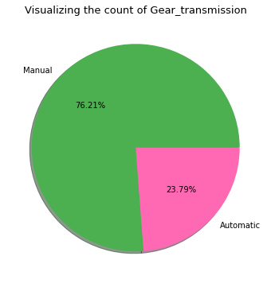
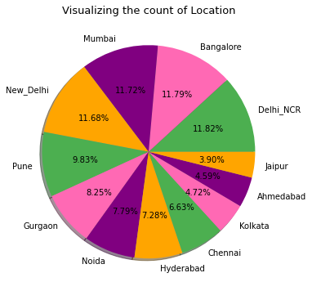
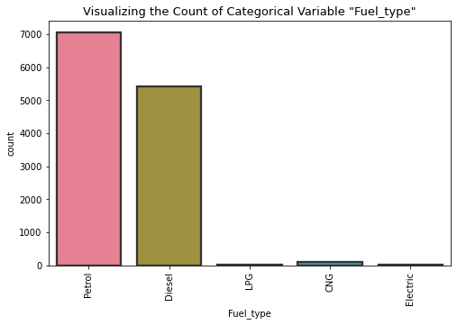
Univariate Analysis: Visualizing Counts of Categorical Variables
The above plot gives the count of transmission, from this graph we can notice that around 76% of the cars are with Manual gear transmission system and only 23% of the cars are with Automatic gear transmission system.
By looking at the above count plot we can get to know that the cars from the city Delhi_NCR, Bangalore, Mumbai and New_Delhi have high counts which are almost similar. And the other locations also have no much difference in the counts.
The above plot gives the count of fuel types used by the cars. More number of cars are using petrol followed by diesel as fuel. And very few cars uses CNG, LPG and Electricity as fuel type.

Slide 13
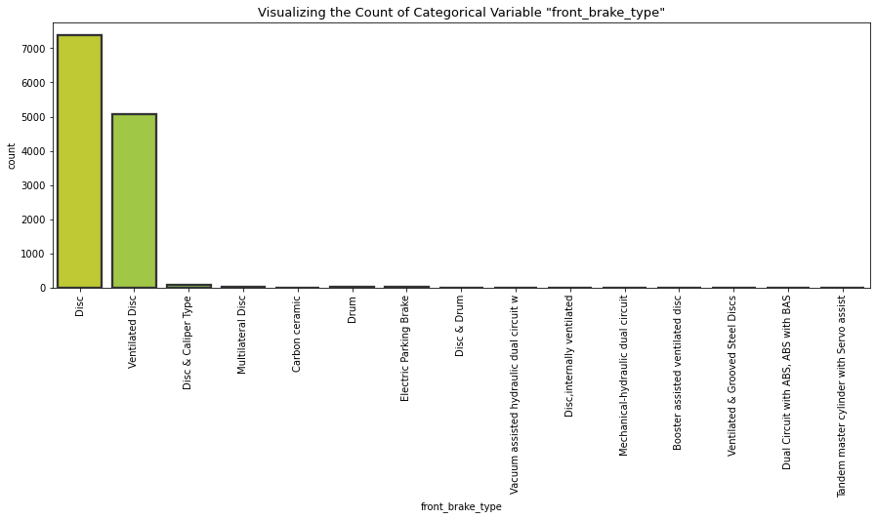
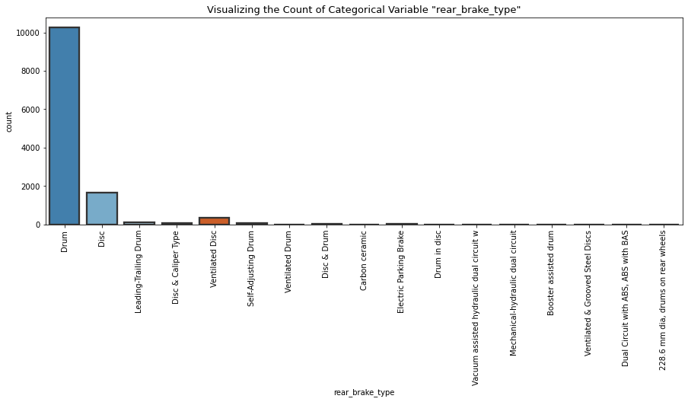
Univariate Analysis: Visualizing Counts of Categorical Variables
By visualizing the above count plot we can conclude that the cars with Disc and Ventilated Disc type of brake system used for front-side wheels are having high count compared to other brake types.
The above graph represents the count of rear_brake_type of the cars which shows that the cars having Drum type of brake system used for back-side wheels are having high count of around 10000 compared to other type of rear brakes.

Slide 14
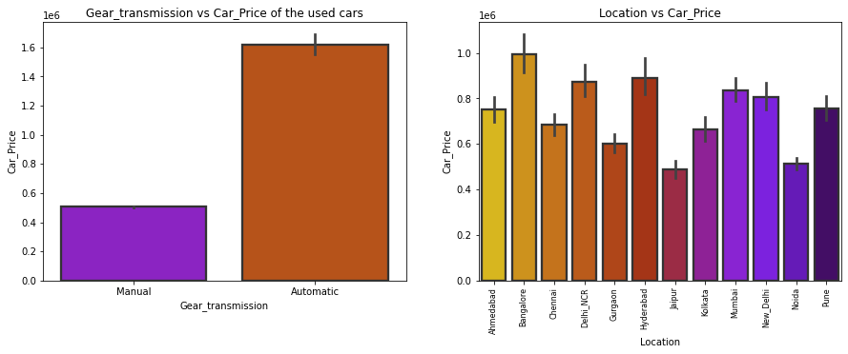
Bivariate Analysis: Visualizing Categorical Variables vs Label
Observations:
Car_Price vs Gear_transmission: From the bar plot we can observe that the cars which have Automatic gear transmission system are having high price compared to the cars which have Manual gear transmission system.
Car_Price vs Location: From the second plot we came to know that the old cars from the city Bangalore have higher price followed by Hyderabad and Delhi_NCR. And the cars from the cities Jaipur, Noida, Gurgaon etc have very less price.

Slide 15
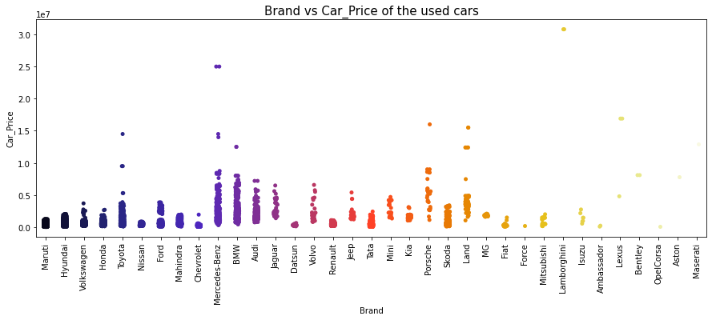
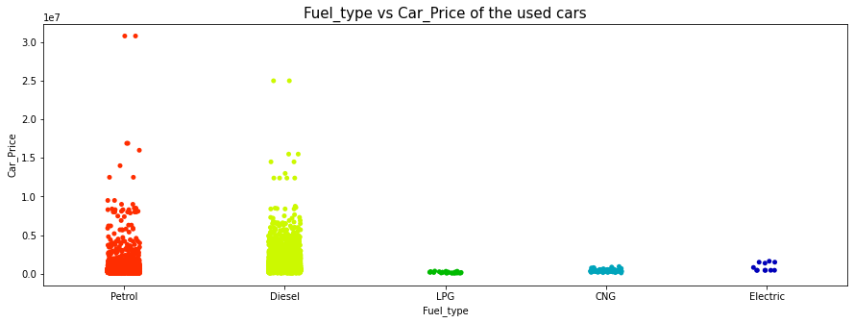
Bivariate Analysis: Visualizing Categorical Variables vs Label
Car_Price vs Brand: The above strip plot shows how the used car prices changes depending on Brands. Here the cars from Mercedes_Benz and BMW brand have high price compared to other brands
Car_Price vs Fuel_type: From the graph we can conclude that a greater number of cars are using Petrol and Diesel fuels and these cars have wide range of price from minimum to maximum. And very few of the cars uses CNG, LPG, and Electricity as fuel type which are not much expensive when compared to that of the diesel and petrol cars.

Slide 16
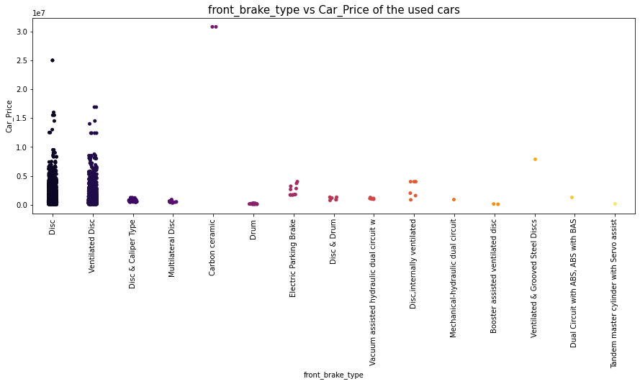
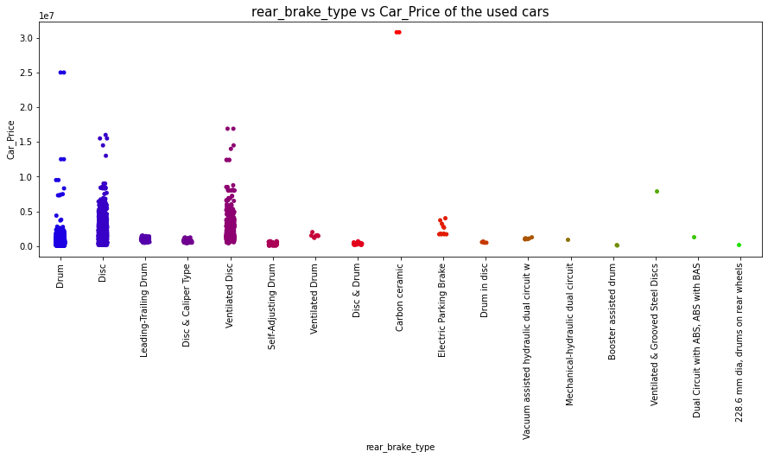
Bivariate Analysis: Visualizing Categorical Variables vs Label
Car_Price vs front_brake_type: Looking at the above bar plot for front_brake_type vs Car_Price we can say that the cars with Disc and Ventilated Disc system for front wheels are having higher prices than other type of braking systems.
Car_Price vs rear_brake_type: The above graph is representing a bar plot for rear_brake_type vs Car_Price which tells us that the cars having Ventilated Disc or Disc or Drum brake system are having higher prices than the cars with other type of braking system at rear side.

Slide 17
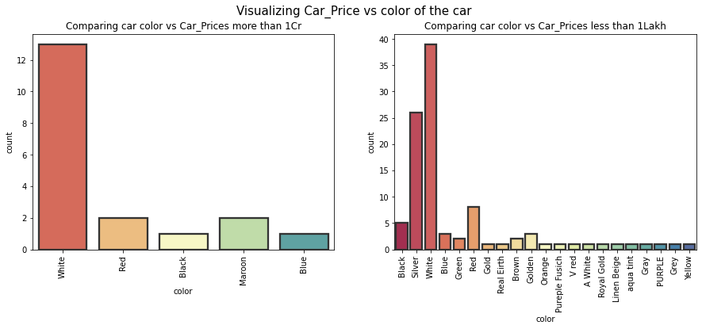
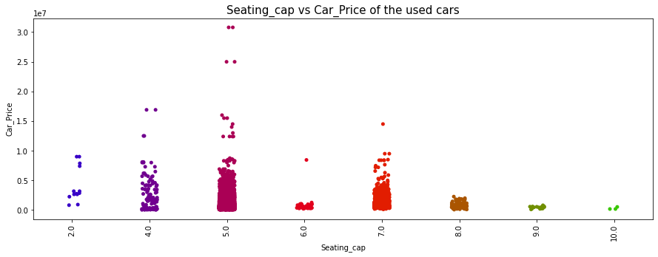
Bivariate Analysis: Visualizing Categorical Variables vs Label
Car_Price vs color: The first count plot is for the car color vs Car_Prices more than 1 Cr. The plot shows the colors of expensive cars. The white color cars are more expensive compared to the cars with other colors.
The second graph is for the car color vs car prices below 1 Lakh and it shows the colors of cars which are cheap. From the plot we can say the cars with Silver color and white color have less price.
Car_Price vs Seating_cap: Most of the cars have seating capacity of 5, 7 and 4 and these cars having higher prices than other cars. And only 3 cars are observed with the seating capacity of 10.

Slide 18
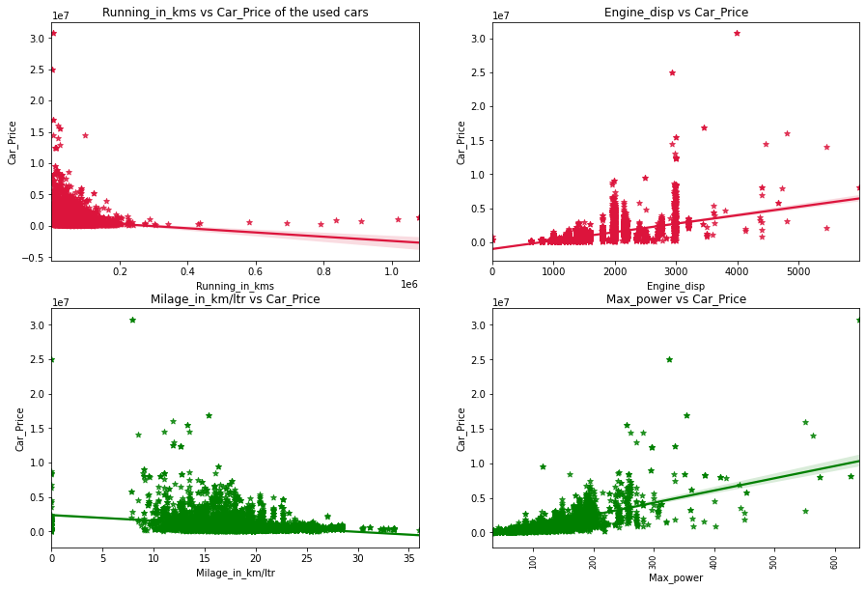
Bivariate Analysis: Visualizing Numerical Variables vs Label
Car_Price vs Running_in_kms: From the plot we can say that the prices of cars are higher for the cars which have less running in kms. We can also notice there is negative linear relation between the price and running of cars.
Car_Price vs Engine_disp: There is a positive correlation between car price and engine displacement. So, we can say as the engine disp or engine cc increases, the price of car also increases.
Car_Price vs Milage_in_km/ltr: The cars having the milage in the range of 10 to 20 km/ltr are having high sale price. From the graph we can also notice there is negative linear/correlation between the price nad milage also some used cars have 0 milage which is unrealistic.
Car_Price vs Max_power: Looking at the graph we can say there is positive correlation between car price and maximum engine power so, we can say as maximum power engine increases, the car prices also go on increasing.

Slide 19
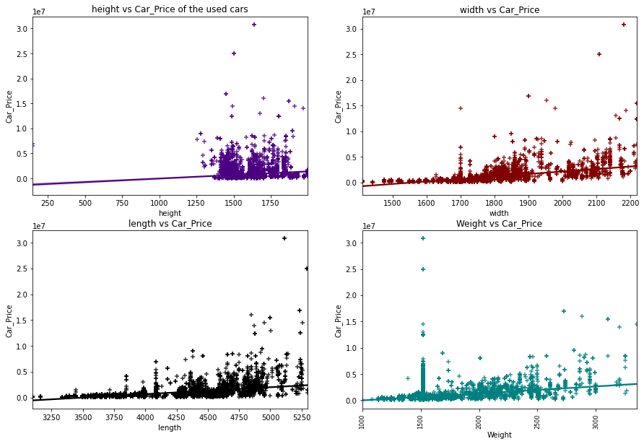
Bivariate Analysis: Visualizing Numerical Variables vs Label
Car_Price vs height: From the graph it is clear that the car price is not strongly related with the height of the car, we can say the cars having height in the range of 1300 mm to 1800 mm have somewhat high price.
Car_Price vs width: The graph shows there is some positive linear relation between car price and width of the car, so the cars having width in the range of 1700mm to 2200mm have high price. So, we can conclude as the width of the car increases, the price of the car also goes on increasing.
Car_Price vs length: There is some positive linear relation between car price and length of the cars. As the length of the cars increases, the price of the cars also increases. The cars that are having the length above 4250mm have high price.
Car_Price vs Weight: There is some positive linear relation between price of the car and weight. The cars with weight 1500kg have high price.

Slide 20
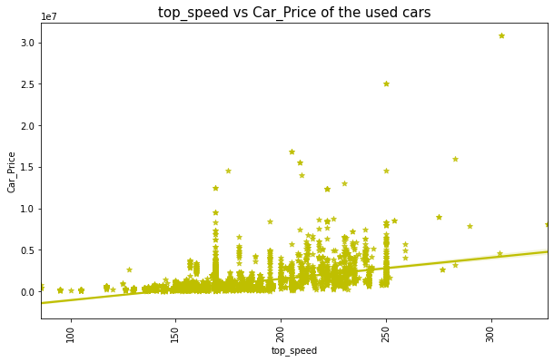
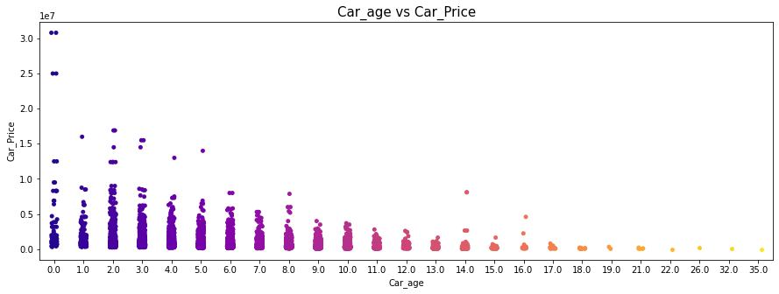
Bivariate Analysis: Visualizing Numerical Variables vs Label
Car_Price vs top_speed: From the graph we can notice there is positive linear relation between car price and maximum speed limit of the car. The cars having top speed in the range of 120 km/hr to 250 km/hr having higher price and there are very less number of cars which have top speed below 100km/hr. So, we can conclude that as the maximum speed limit of the car (top_speed) increases, the car price also increases.
Car_Price vs Car_age: From the above strip plot we can say that the older cars are having very lower prices when compared to the new cars that is the cars having very less age. So, there is negative relation between car price and age of the cars and we can conclude as the age decreases, the car prices increase.

Slide 21
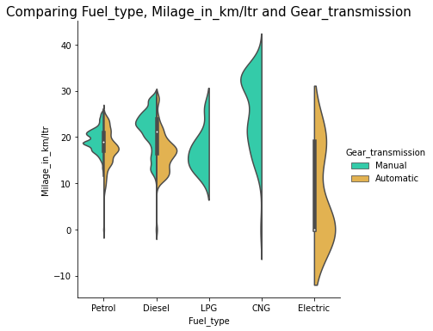
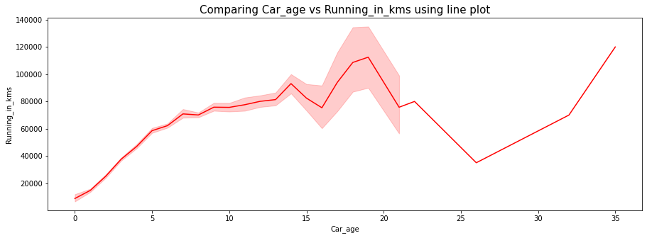
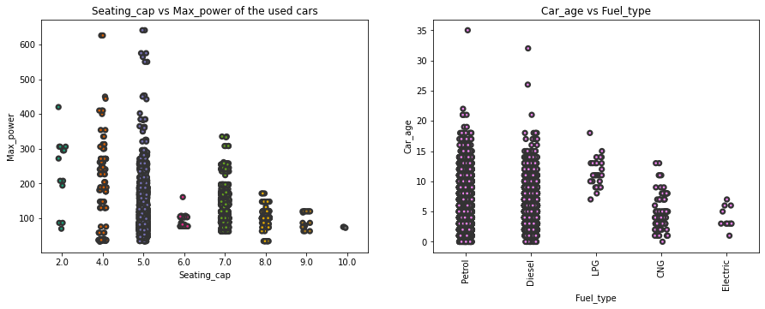
Bivariate Analysis: Visualizing Two Independent Variables
Fuel_type vs Milage_in_km/ltr: The violin plot gives the relation between Milage in km/ltr and Fuel type on the basis of gear transmission. As we can observe the cars with Manual gear transmission which are using CNG as a fuel are having good milage compared to other fuel types.
Car_age vs Running_in_kms: The above graph represents car_age vs Running in kms. The cars which have their age from 2 years to 16 years have highly used. That is the running kms for these cars are around 1 lakh kms.
Seating_cap vs Max_power: The cars with seating capacity 5 have high maximum power of engine used in cars and the cars with 10 seating capacity have very less maximum engine power.
Fuel_type vs Car_age: The cars which are using Patrol and Diesel as fuel they have high age and the cars with low age are using electricity as the fuel.

Slide 22
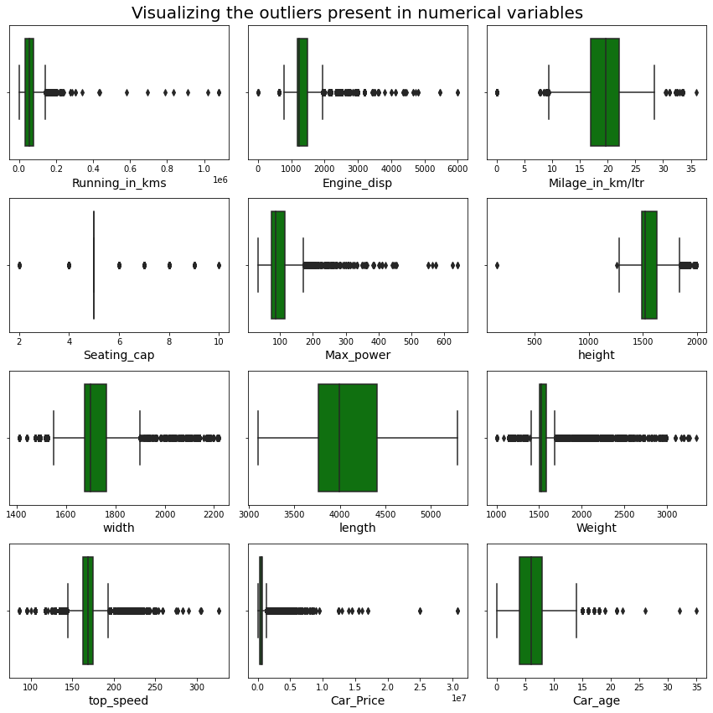
Identifying the outliers using box plot
A box plot is used to summarize data sets by using the box and whisker plot method. This function helps to understand the data summary properly. Box plots can be very useful when we want to know how the data is distributed and spread. Three types of quartiles are used in the box plot to plot the data. These values include the median, maximum, minimum, upper-quartile, and lower-quartile statistical values. A box plot summarizes this data in the 25th, 50th, and 75th percentiles.
From the box plot we can notice the outliers present in all the features except length column. I have removed the outliers using Zscore method except length and Car_Price. Since Car_Price is our target column we should not loose any data by removing outliers in this column.

Slide 23
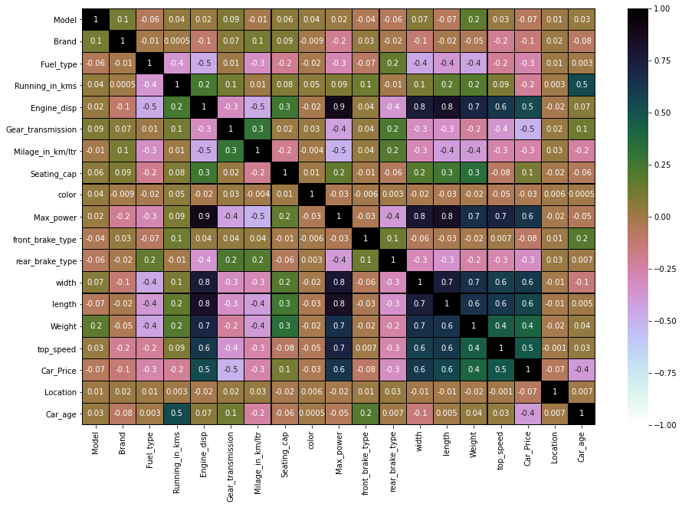
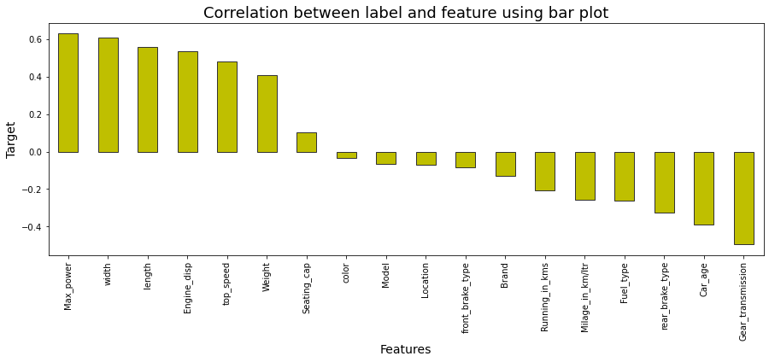
Correlation Between Features and Label
From the heat map and bar plot we can clearly observe the positive and negative correlation between the label and features. From the heat map we can notice that the dark shades are highly positively correlated and light shades are highly negatively correlated with the target variable.
We can observe from the map that most of the columns are highly correlated with each other which leads to multicollinearity problem. So, I checked the VIF value and removed the columns having high VIF value to overcome with this multicollinearity problem.

Slide 24
Data Analysis Steps done
I have done feature engineering steps like feature extraction and feature selection to improve data normality and linearity.
Identified outliers using boxplots and removed outliers using Zscore method.
Identified skewness using distribution plots and removed skewness using power transformation method (yeo-johnson method).
Used Pearson’s correlation coefficient to check the correlation between dependent and independent variables. To visualize the correlation I have used heatmap and bar plot. Checked for VIF and solved multicollinearity problem.
I have used StandardScalar method to scale the data to overcome with the issue of data biasness.
Split train and test to build machine learning models. Found best random state and best accuracy. Model building process will be shown in the further steps.

Slide 25
Assumptions:
Firstly, from the problem statement we got to know that it is a Regression type problem for which we used Regression algorithms to build the model and predicted the sale price of used cars by collecting the data from cardekho website using web scraping.
Secondly, from the distribution plots and box plots I found skewness and outliers in almost all the columns. Also, based upon the analysis and visualization part we have seen some of the features having linear relation with label. So, I assumed these features helps in model building and to predict sale price of the old cars. Also, this model helps the car selling dealers/companies and buyers understand the feature price of the cars.
So, I suggest that the dealers and buyers take this model into consideration the features that were deemed as most important as seen in this study might help them estimate the car price.

Slide 26
Model Building:
In this problem Car_Price is our target variable which is continuous in nature where we need to predict the price of pre-owned cars. From this I can conclude that it is a Regression type problem hence I have used following regression algorithms.
After the pre-processing and data cleaning I left with 18 columns including target and with the help of feature importance bar graph I used these independent features for model building and prediction. The algorithms used on training the data are as follows:
Decision Tree Regressor
Random Forest Regressor
Extra Trees Regressor
Gradient Boosting Regressor
Extreme Gradient Boosting Regressor (XGB)
Bagging Regressor
Kneighbors Regressor
I have got the best random state and maximum R2 score and then created train test split to build the above models.

Slide 27
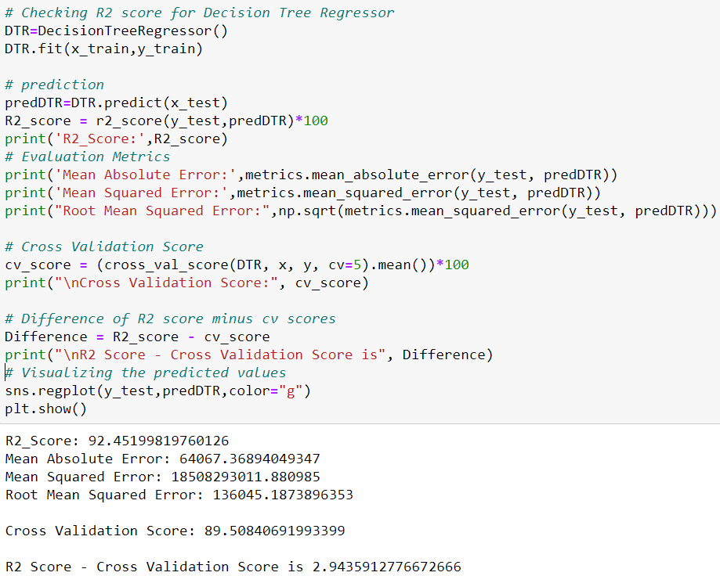
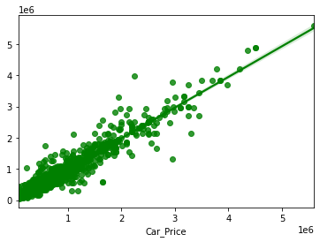
Decision Tree Regressor
Created Decision Tree Regressor model and checked for its evaluation metrics. The model is giving R2 score as 92.45%.
From the graph we can observe how our model is mapping. In the graph we can observe the straight line which is our actual dataset and dots are the predictions that the model has given.

Slide 28
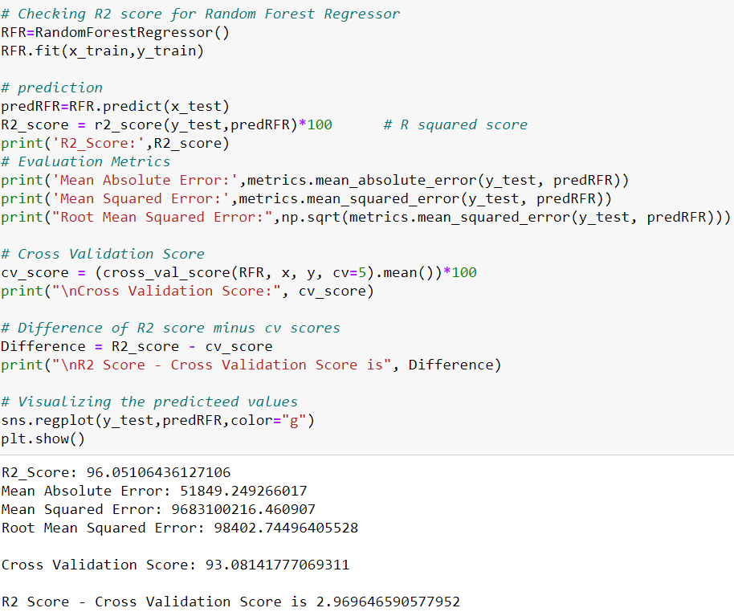
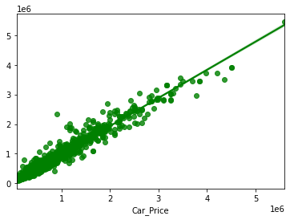
ii. Random Forest Regressor:
Created Random Forest Regressor model and checked for it's evaluation metrics. The model is giving R2 score as 96.05%.
From the graph we can observe how our model is mapping. In the graph we can observe the straight line which is our actual dataset and dots are the predictions that our model has given.

Slide 29
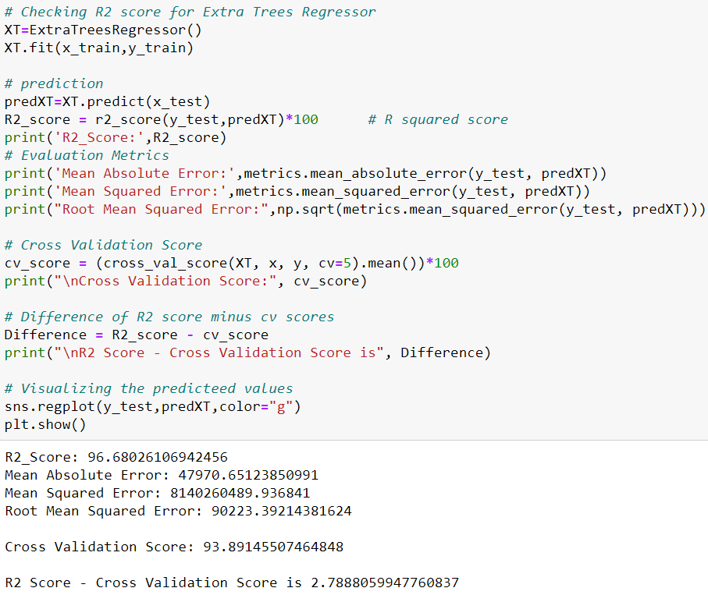
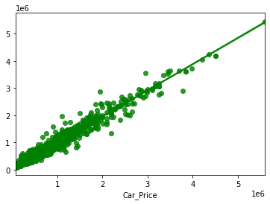
iii. Extra Trees Regressor:
We have created Extra Trees Regressor model and checked for its evaluation metrics. And the model is giving R2 score as 96.68%.
From the graph we can observe how our model is mapping. In the graph we can observe the straight line which is our actual dataset and dots are the predictions that our model has given.

Slide 30
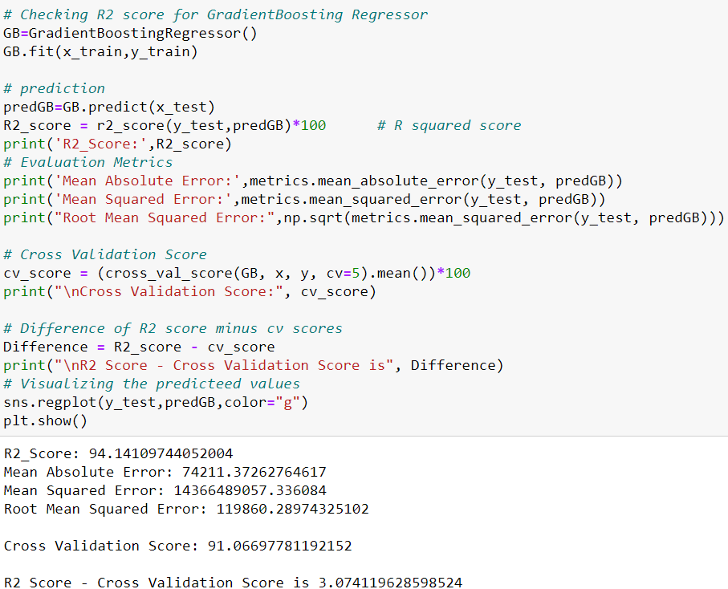
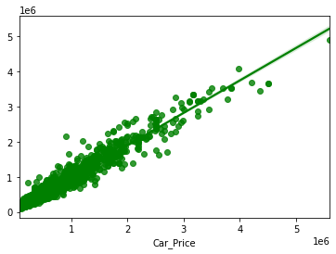
iv. Gradient Boosting Regressor:
Created Gradient Boosting Regressor model and checked for its evaluation metrics. The model is giving R2 score as 94.14%.
From the graph we can observe how our model is mapping. In the graph we can observe the straight line which is our actual dataset and the dots are the predictions that our model has given.

Slide 31
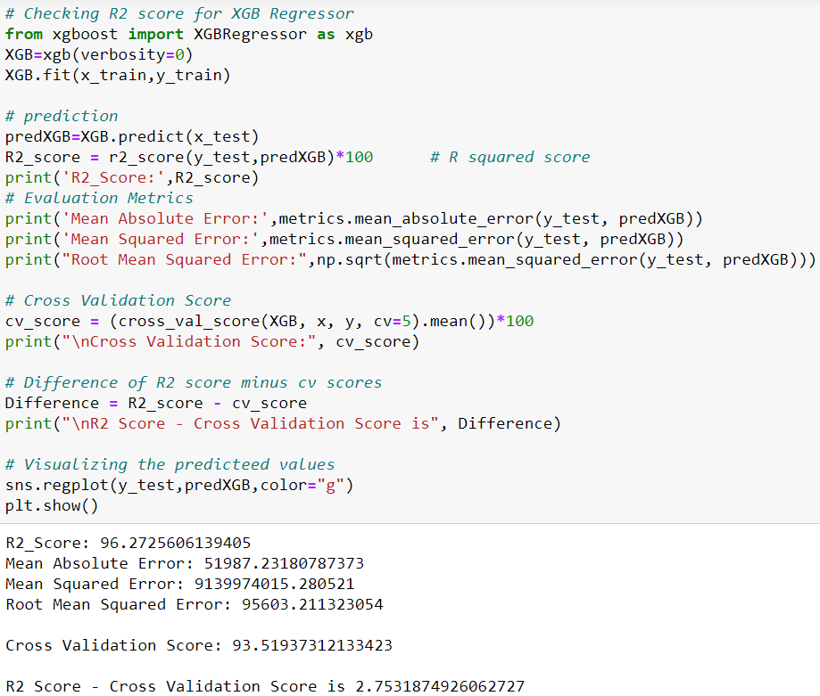

v. Extreme Gradient Boosting Regressor (XGB):
Created XGB Regressor model and checked for its evaluation metrics. The model is giving R2 score as 96.27%.
From the graph we can observe how our model is mapping. In the graph we can observe the straight line which is our actual dataset and the dots are the predictions that our model has given.

Slide 32
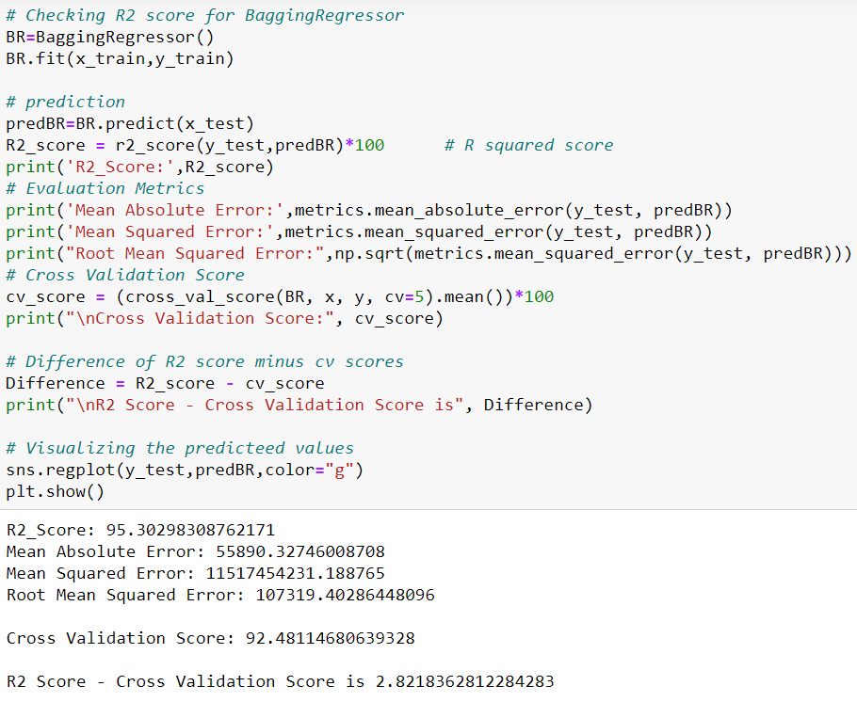
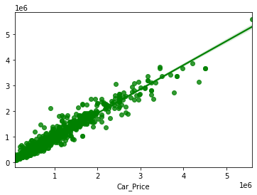
vi. Bagging Regressor:
Created Bagging Regressor model and checked for its evaluation metrics. The model is giving R2 score as 95.30%.
From the graph we can observe how our model is mapping. In the graph we can observe the straight line which is our actual dataset and the dots are the predictions that our model has given.

Slide 33
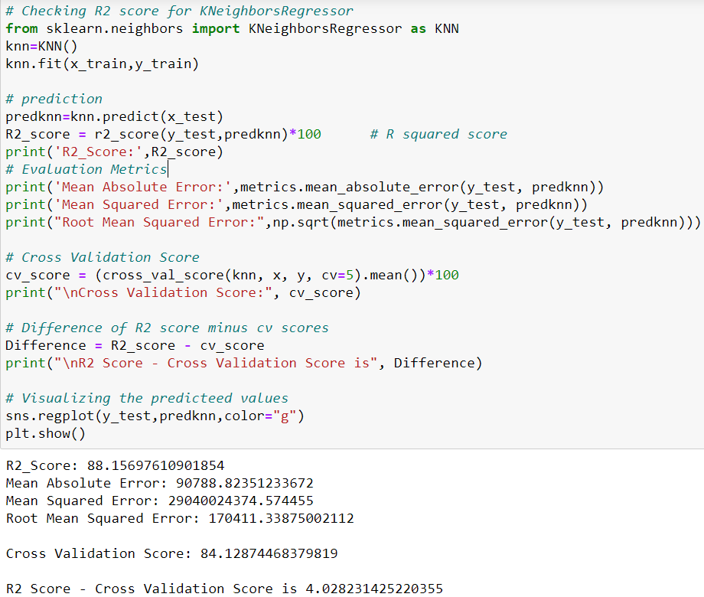
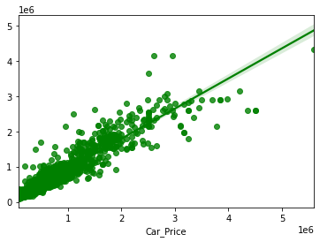
vii. KNeighbors Regressor
Created KNN Regressor model and checked for its evaluation metrics. The model is giving R2 score as 88.15%.
From the graph we can observe how our model is mapping. In the graph we can observe the straight line which is our actual dataset and the dots are the predictions that our model has given.

Slide 34
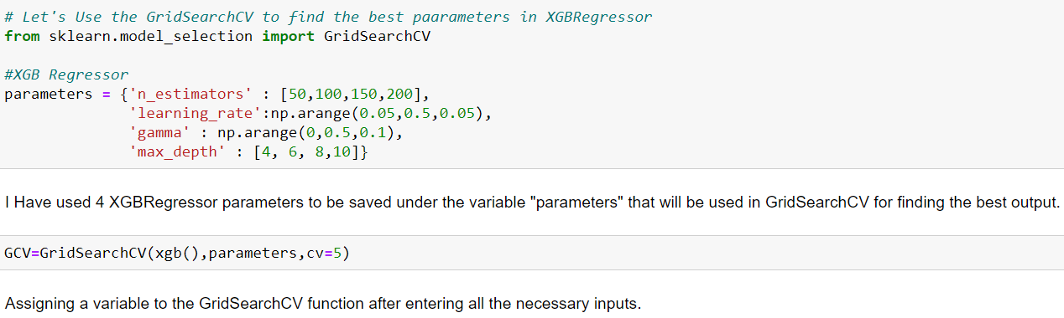
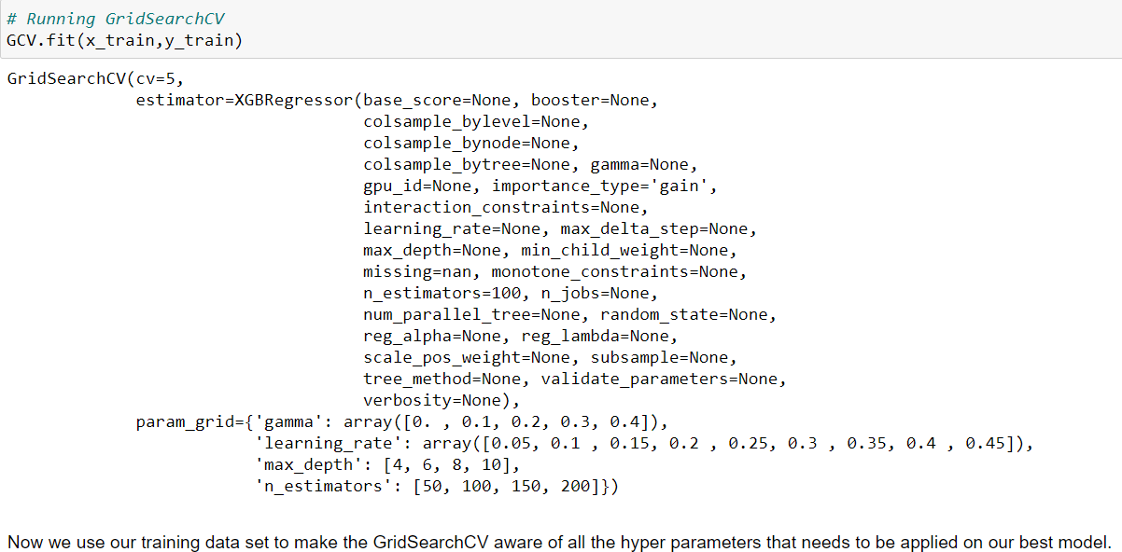
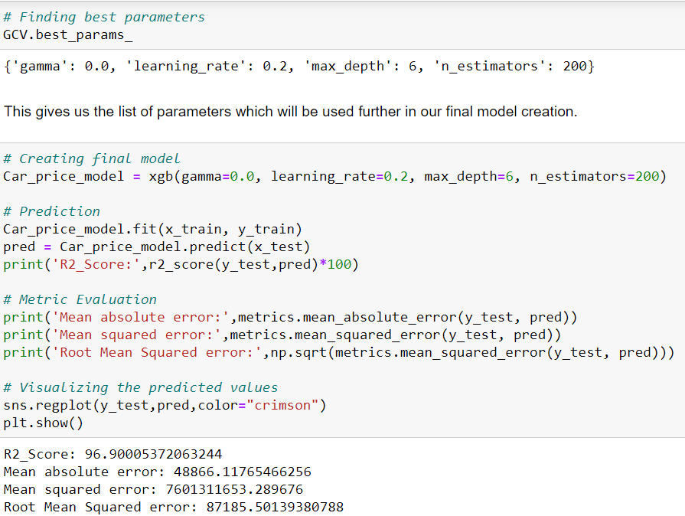
Hyperparameter Tuning:
From the difference between R2 score and cross validation score we found “Extreme Gradient Boosting Regressor” (XGB) having least difference compared to other models. So, we concluded that “Extreme Gradient Boosting Regressor” as our best fitting model. Performed Hyperparameter tuning to increase the best model accuracy.
I have used GridSearchCV to get the best parameters of Extreme Gradient Boosting Regressor (XGB Regressor). And used all the obtained best parameters to create the accuracy of final model.

Slide 35
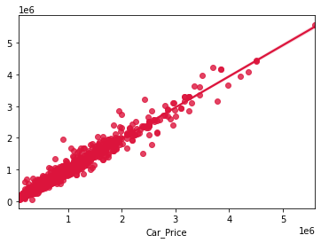
Creating Final Model After Tuning:
I have successfully incorporated the hyper parameter tuning using best parameters of XGB Regressor by using GridSearchCV and the R2 score of the model has been increased after hyperparameter tuning and received the R2 score as 96.90% which is very good.
From the graph we can observe how our final model is mapping. In the graph we can observe the best fit line which is our actual dataset and the dots are the predictions that our best final model has given.

Slide 36
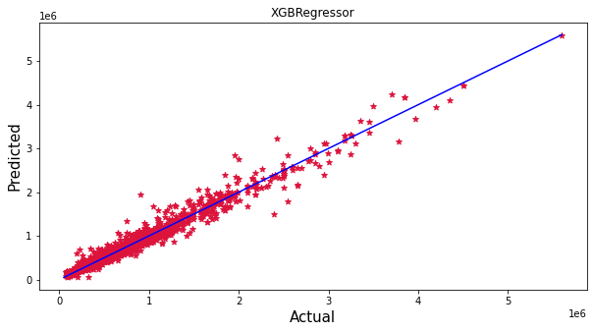
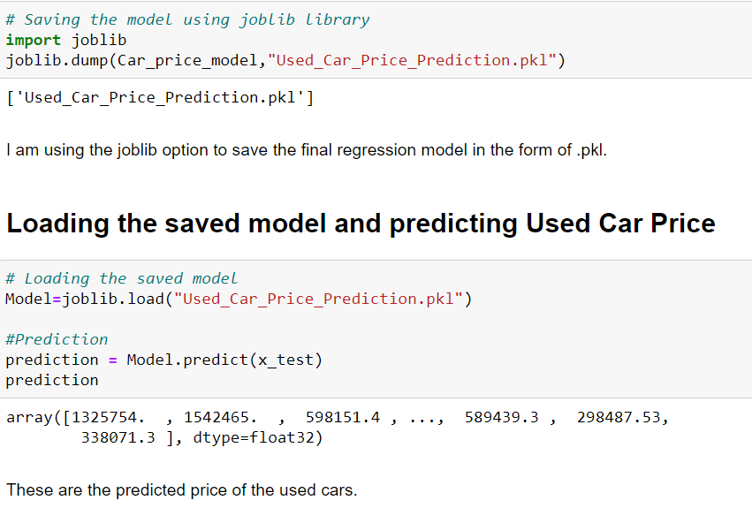
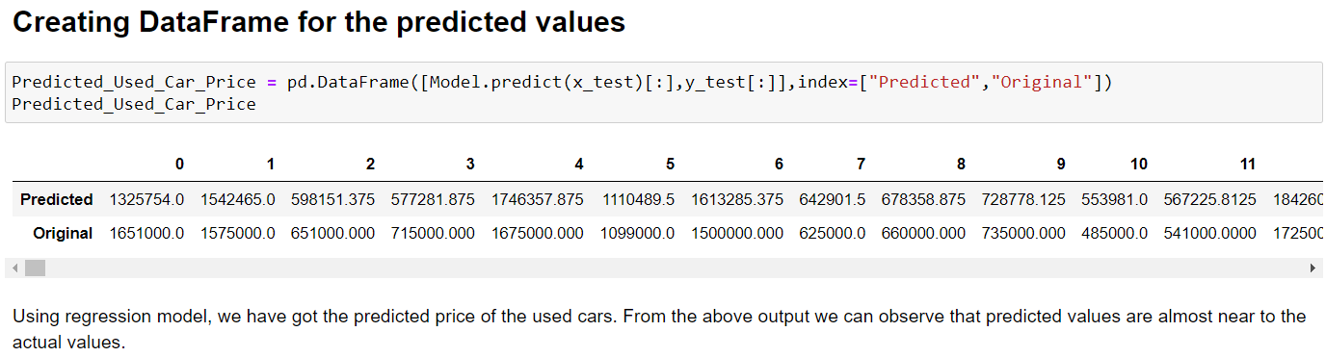
Saving The Final Model And Predictions From Saved Model
I have saved my final best model using joblib library in .pkl format, and loaded saved model for predictions.
Using regression model, we have got the predicted sale price of the cars. From the predictions we can notice both actual values and predicted values are almost same.
The graph shows how our final model is mapping. The plot gives the linear relation between predicted and actual price of the used cars. The blue line is the best fitting line which gives the actual values/data and red dots gives the predicted values/data.

Slide 37
Conclusion:
The case study aims to give an idea of applying Machine Learning algorithms to predict the sale price of the used cars. After the completion of this project, we got an insight of how to collect data, pre-processing the data, analyze and cleaning the data and building a model.
First we collected the used cars data from website www.cardekho.com and it was done by using Web scraping using the framework Selenium, which has an advantage of automating our process of collecting data. We collected almost 12608 of data which contained the selling price of the used cars and other related features. Then, the scrapped data was saved in a excel file so that we can use further and analyze the data.
Then we loaded the dataset and have done data cleaning, EDA process and pre-processing techniques like checking outliers, skewness, correlation, scaling data etc and got better insights from data visualization.
From the visualizations we got to know that the continuous numerical variables having some positive linear relation with the "Car_Price". By comparing car price and categorical variables we got to know that the cars having automatic gear transmission, cars from the city Bangalore, cars using petrol and diesel as fuels, cars having brands Benz and BMW and cars with 5-7 seating capacity have high sale price. While comparing continuous numerical variables and Car_Price we found that cars which are having good milage, engine displacement, less running in kms have good linear relation with the price that is the cars with this kind of qualities have high selling prices.
After separating our train and test data, we started running different ML regression algorithms to find out the best performing model on the basis of different metrics like R2 Score MAE, MSE, RMSE. We got XGBoost Regressor as the best model among all the models as it gave least difference of R2 score and cross validation score also low evaluation metrics compared to other models. On this basis we performed the Hyperparameter tuning to find out the best parameter and improving the scores. The R2 score increased after tuning so, we concluded that XGBoost Regressor as the best model as it was giving high R2 score after tuning.

Slide 38
Thank You

